Slide 1

Institut Teknologi Sepuluh Nopember
Surabaya, Indonesia
V.23092024

Slide 2

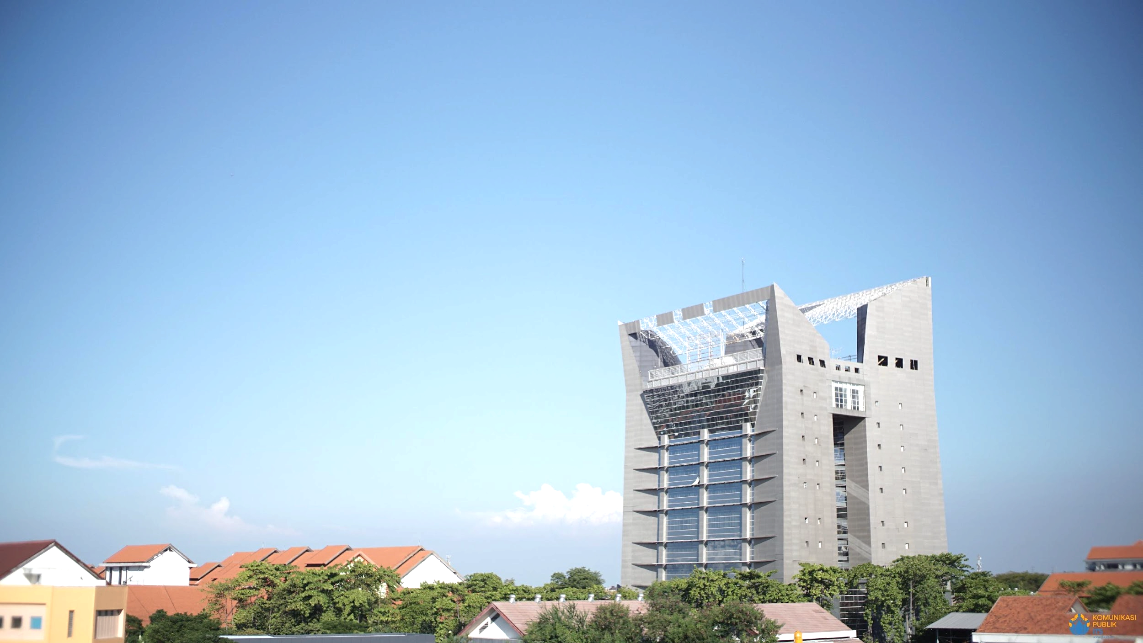

Institut Teknologi Sepuluh Nopember Surabaya (ITS) is Indonesia's prominent research university in fields of engineering, science, technology, marine, design, and business. Established in 1960, ITS aims to be an entrepreneurial university through commercialization of ITS’ research and innovations

Slide 3
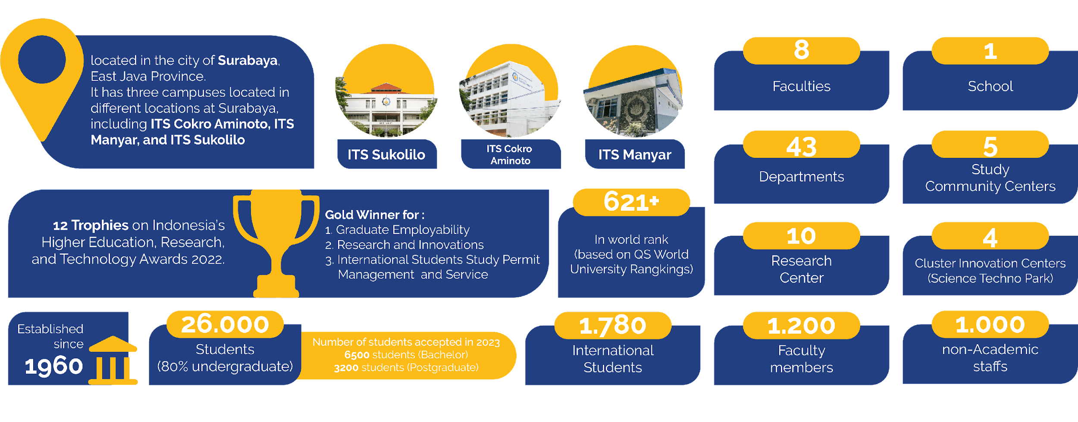
FAST FACTS ITS
585
27.000
*
*number of international students participating in various inbound mobility program in ITS including short program, exchange, internships, and full degree in 2022

Slide 4

ITS’ RANKINGS
RANK
#128
ASIA
RANK
#6
INDONESIA
RANK
#=378
ENGINEERING & TECHNOLOGY
#585
QS ASIA UNIVERSITY RANKINGS 2024
QS WORLD UNIVERSITY RANKINGS 2025
QS WUR BY SUBJECT 2024 (BROAD)
World Rank 2025
RANK
#351-400
CHEMICAL ENGINEERING
RANK
#351-400
MECHANICAL, AERONAUTICAL & MANUFACTURING
RANK
#451-500
COMPUTER SCIENCE &
INFORMATION SYSTEMS
QS WUR BY SUBJECT 2024 (SPECIFIC)
QS WUR BY SUBJECT 2024 (SPECIFIC)
QS WUR BY SUBJECT 2024 (SPECIFIC)
RANK
#351-400
ELECTRICAL & ELECTRONIC
RANK
#586
WORLD
QS WUR BY SUBJECT 2024 (SPECIFIC)
QS WUR SUSTAINABILITY 2024

Slide 5

ITS’ RANKINGS
RANK
#1201+
WORLDWIDE
RANK
#501-600
ASIA
RANK
Group #2
INDONESIA
64
THE WORLD UNIVERSITY RANKINGS 2024
THE ASIA UNIVERSITY RANKINGS 2024
THE WORLD UNIVERSITY RANKINGS 2024
RANK
#801-1000
COMPUTER SCIENCE
RANK
#1001+
ENGINEERING & TECHNOLOGY
RANK
#1001+
PHYSICAL SCIENCES
World University Impact Ranking 2021
THE WUR BY SUBJECT 2024
THE WUR BY SUBJECT 2024
THE WUR BY SUBJECT 2024
1
RANK
#801+
BUSINESS & ECONOMICS
RANK
#601-800
SOCIAL SCIENCES
RANK
#201-300
IMPACT RANKINGS
Indonesia University Impact Ranking 2021
THE WUR BY SUBJECT 2024
THE WUR BY SUBJECT 2024
THE IMPACT RANKINGS 2024

Slide 6











CONSORTIUMS
University Mobility In Asia And The Pacific (UMAP)
National Secretariat for Indonesia
ATU-Net
Asia Technological University Network
Deputy Chair for SIG Mobility
WAEJUC
(Western Australia – East Java Universities Consortium)
Coordinator for Mobility in EJU
ACNET-EngTech
(ASEAN-China Network for Cooperation and Exchanges among Engineering and Technology Universities)
Interweave & IMPAKT (Erasmus Mundus)
ERASMUS+
AIC
(Australia Indonesia Centre)
JWGEA
(Joint Workshop for Global Engineers in Asia)
BRAUIC
Belt Road Architectural University International Consortium
AUN/SEED-Net
(ASEAN University Network/Southeast Asia Engineering Education Development Network)
GTI
(Global Technology Initiative)
KU+EPI
(Kumamoto University and Eastern Part of Indonesia Universities)
Mevlana
Flagship Project of
Turkish Government for Mobility
SATU
Southeast Asian & Taiwan University Consortium
ASEAN International Mobility For Students (AIMS)
ASEA-UNINET
(The ASEAN European Academic University Network)
FICEM
French & Indonesia Consortium in Engineering & Management
GE4 Network
Global Education: Exchanges for Engineers and Entrepreneurs
COMSATS
Commission on Science & Technology for Sustainable Development in the South

Slide 7




































ITS AS A HUB FOR EASTERN PART OF
INDONESIAN UNIVERSITIES (EPI-UNET)
JOINT RESEARCH/PUBLICATION
INTERNATIONAL OFFICE
QUALITY ASSURANCE

Slide 8
FACULTIES AND DEPARTMENTS
SCIENTICS
(FACULTY OF SCIENCE AND DATA ANALYTICS)
(INDSYS)
FACULTY OF INDUSTRIAL TECHNOLOGY & SYSTEMS ENGINEERING
CIVPLAN
(FACULTY OF CIVIL, PLANNING, AND GEO ENGINEERING)
MARTECH
(FACULTY OF MARINE TECHNOLOGY)
ELECTICS
(FACULTY OF INTELLIGENT ELECTRICAL & INFORMATICS TECHNOLOGY)
  Physics
  Mathematics
  Statistics
  Chemistry
  Biology
  Actuarial Science
  Mechanical Engineering
  Chemical Engineering
  Engineering Physics
  Systems and Industrial Engineering
  Materials and Metallurgical Engineering
  Food Technology
  Civil Engineering
  Architecture
  Environmental Engineering
  Regional and Urban Planning
  Geomatics Engineering
  Geophysics Engineering
  Naval Architecture and Shipbuilding Engineering
  Marine Engineering
  Ocean Engineering
  Sea Transportation Engineering
  Offshore Engineering
  Electrical Engineering
  Biomedical Engineering
  Computer Engineering
  Informatics
  Information Systems
  Information Technology
6 Vocational Programs
27 Masters Programs
17 International Undergraduate Programs
17 Doctoral Programs
1 Engineer Professional Program
Bachelor Degree
Master Degree
Doctoral Degree

Slide 9
FACULTIES AND DEPARTMENTS
CREABIZ
(FACULTY OF CREATIVE DESIGN AND DIGITAL BUSINESS)
VOCATIONS
(FACULTY OF VOCATIONAL STUDIES)
MEDICS
(FACULTY OF MEDICINE AND HEALTH)
SCHOOL OF INTERDISCIPLINARY AND TECHNOLOGY MANAGEMENT
  Industrial Product Design
  Interior Design
  Visual Communication Design
  Business Management
  Developmental Studies
  Chemical Industrial Engineering
  Civil Infrastructure Engineering
  Industrial Mechanical Engineering
  Electrical Automation Engineering
  Business Statistics
  Instrumentation Engineering
  Medical Technology Program
  Academic Stage of Medical Program
  Professional Stage of Medical Program
  Technology Management
  System Innovation and Technology
  Engineer Professional Program
Bachelor Degree
Master Degree
Doctoral Degree

Slide 10
INTERNATIONAL UNDERGRADUATE PROGRAM (IUP)
SCIENTICS
(FACULTY OF SCIENCE AND DATA ANALYTICS)
(INDSYS)
FACULTY OF INDUSTRIAL TECHNOLOGY & SYSTEMS ENGINEERING
CIVPLAN
(FACULTY OF CIVIL, PLANNING, AND GEO ENGINEERING)
MARTECH
(FACULTY OF MARINE TECHNOLOGY)
  Statistics
  Mechanical Engineering
  Chemical Engineering
  Engineering Physics
  Industrial and System Engineering
  Materials and Metallurgical Engineering
  Civil Engineering
  Architecture
  Environmental Engineering
  Geomatics Engineering
  Geophysics Engineering
  Urban and Regional Planning
  Naval Architecture
ELECTICS
(FACULTY OF INTELLIGENT ELECTRICAL & INFORMATICS TECHNOLOGY)
CREABIZ
(FACULTY OF CREATIVE DESIGN AND DIGITAL BUSINESS)
Apply now: https://www.its.ac.id/international/experiencing-its/prospective-student/
  Electrical Engineering
  Informatics
  Information System
  Business Management
Further Information:
Email: admisi@its.ac.id
https://www.its.ac.id/international/experiencing-its/prospective-student/admission/iup/

Slide 11
ITS RESEARCH CENTERS
Sustainable Energy Research Center
Disaster Mitigation and Climate Change Research Center
Artificial Intelligence and Health Technology Research Center
Marine and Earth Science and Technology Research Center
Advanced Materials and Nanotechnology Research Center
Sustainable Infrastructure and Environment Research Center
Internet of Things and Defense Technology Research Center
Fundamental Science Research Center
Agri-food and Biotechnology Research Center
Manufacturing, Transportation, and Logistics Research Center

Slide 12


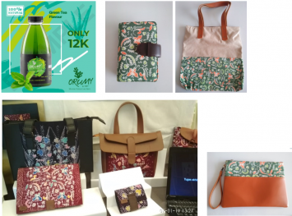
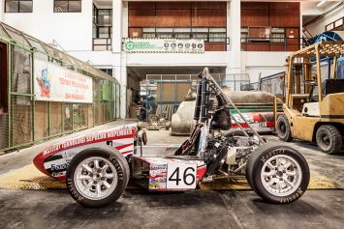

ITS STUDY CENTERS
Regional Potential Community Empowerment Study Center
Halal Study Center
Sustainable Development Goals Study Center
Appropriate Technology Study Center
Business & Industry Public Policy Study Center

Slide 13
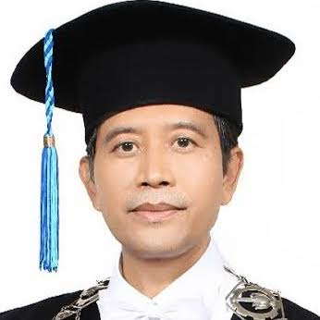
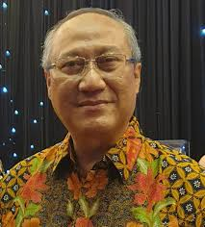
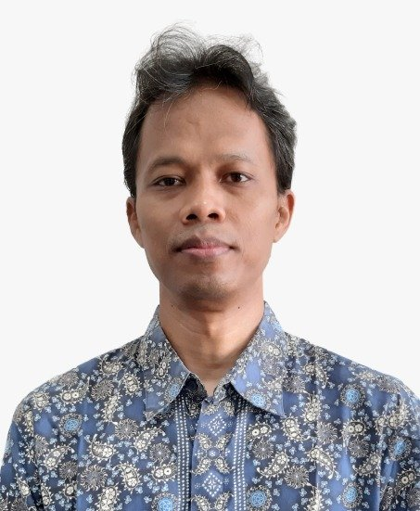
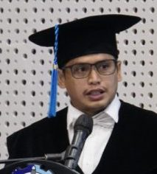
ITS’ TOP 2% WORLD’s SCIENTISTS
Prof. I Nyoman Pujawan
Logistics and Supply Chain
Prof. Riyanarto Sarno
Computer Science
Prof. Tohari Ahmad
Computer Science
Prof. Adi Setyo Purnomo
Chemistry
Top 2% Scientist in the World: Single Year Impact 2024 - 2025 by Stanford University and Elsevier Report

Slide 14
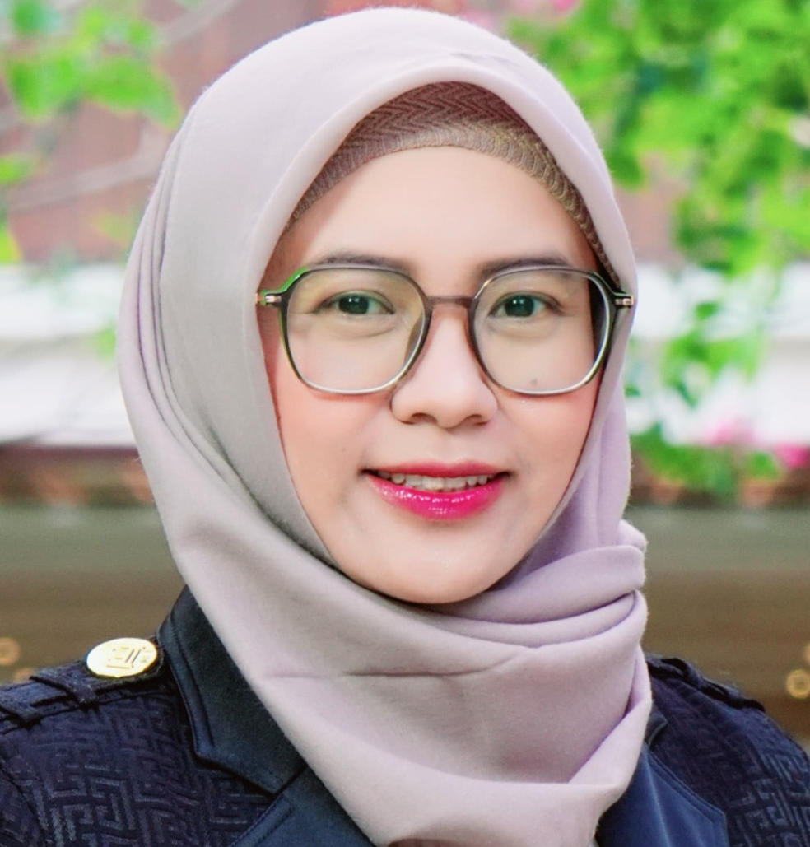
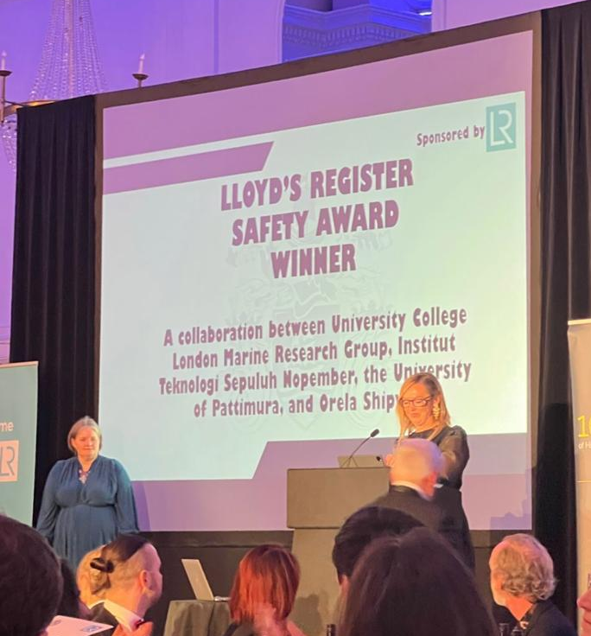
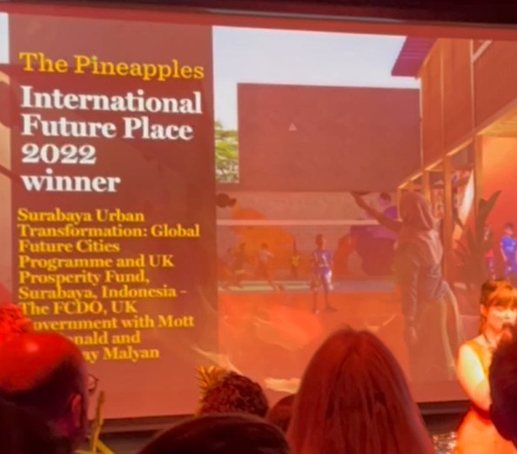
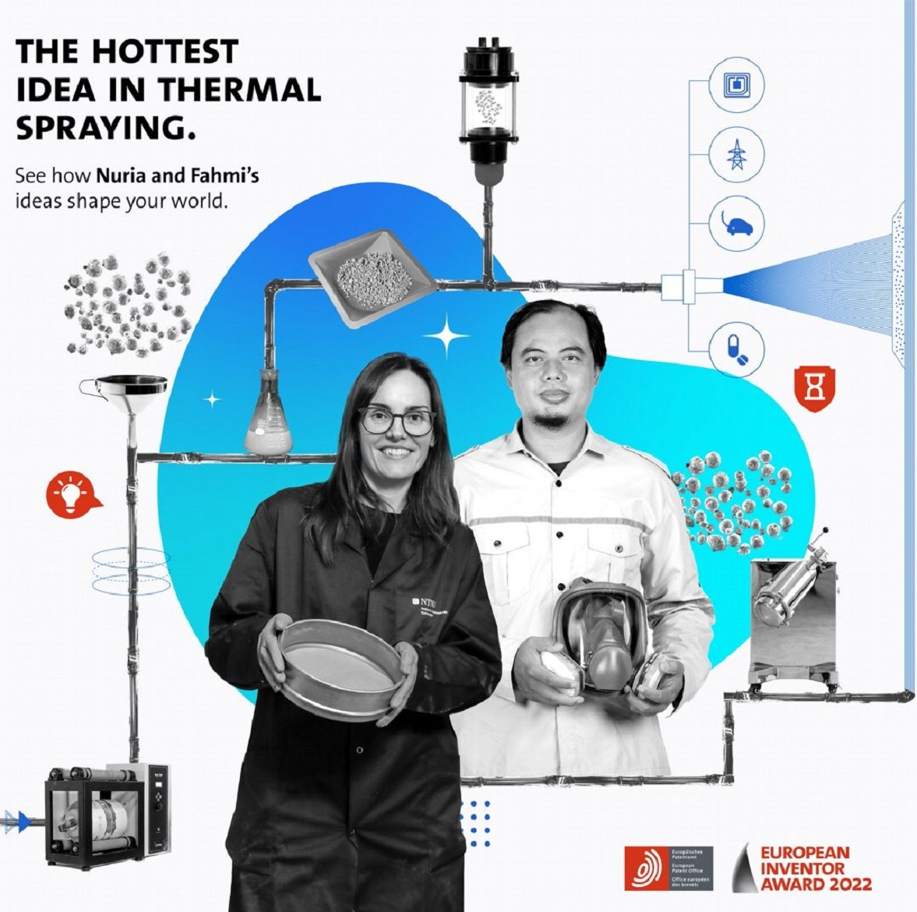
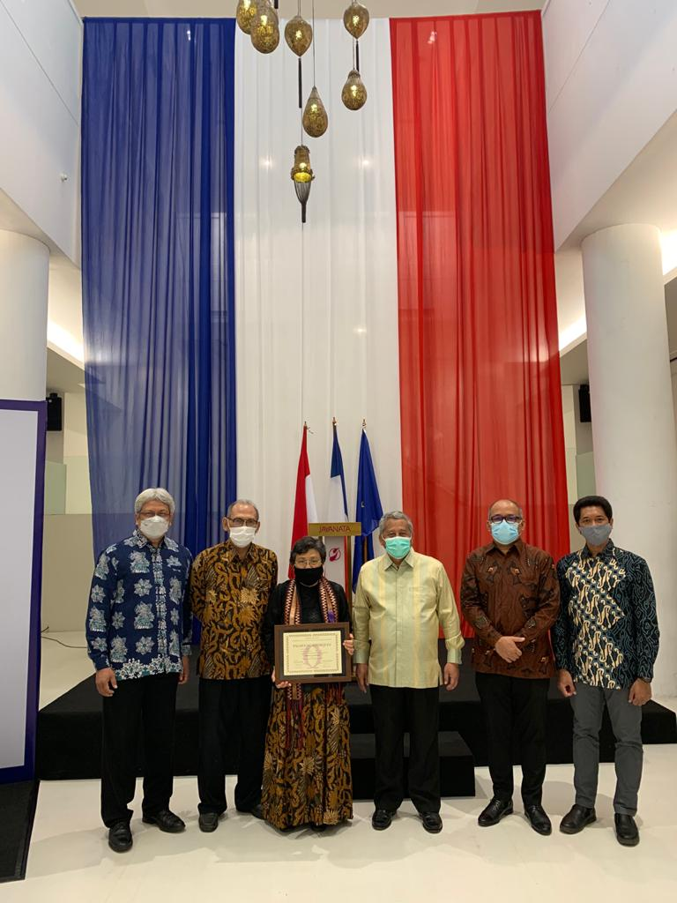
FACULTY MEMBER’S ACHIEVEMENTS
1
2
Dr. Sri Fatmawati – Chemistry Dept ITS first woman to be awarded Dr. Wilmar Schwabe Award 2024 in July 2024, in Krakow, Poland
Prof. I Ketut Aria Putra Utama of Naval Architecture Department, ITS research collaboration with UCL London, won Lloyd’s Register Maritime Safety Awards in April 2023
Mr. Andi Mappajaya, a lecturer in Architecture Dept won the International Future Place 2022 with his design, “The Pineapples."
Dr. Fahmi Mubarok as a nominee of Innovation Prize European Patent Office in the European Inventor Award 2022
Prof Ria Asih of Civil Engineering Department is a receiver of prestigious award “Chevalier dans L’Ordre des Palmes Academiques” from French Government
3
4
5

Slide 15
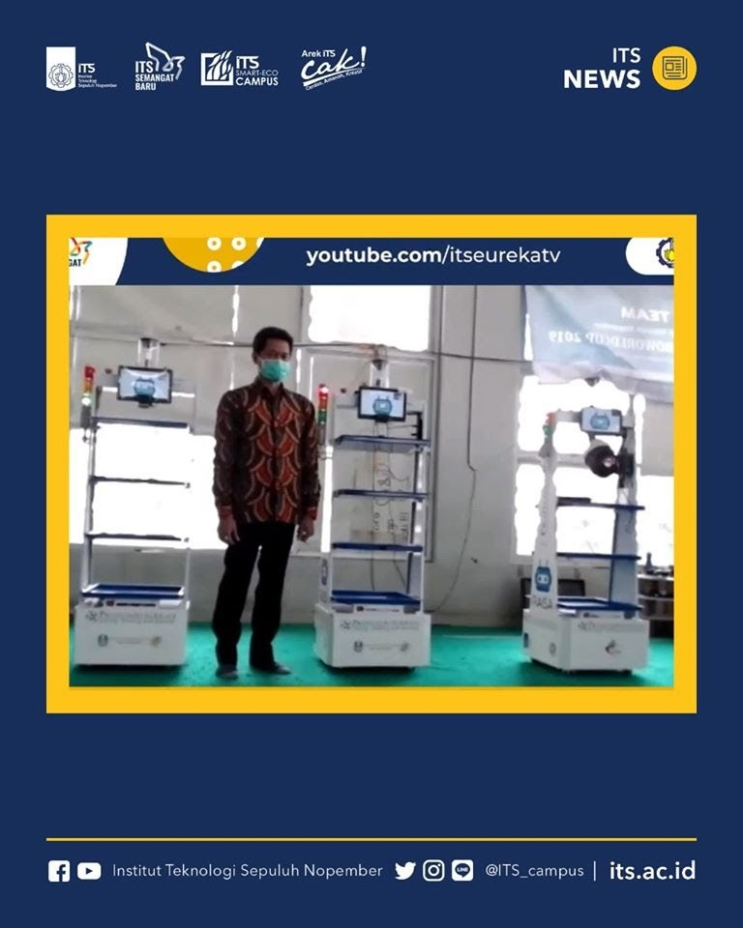
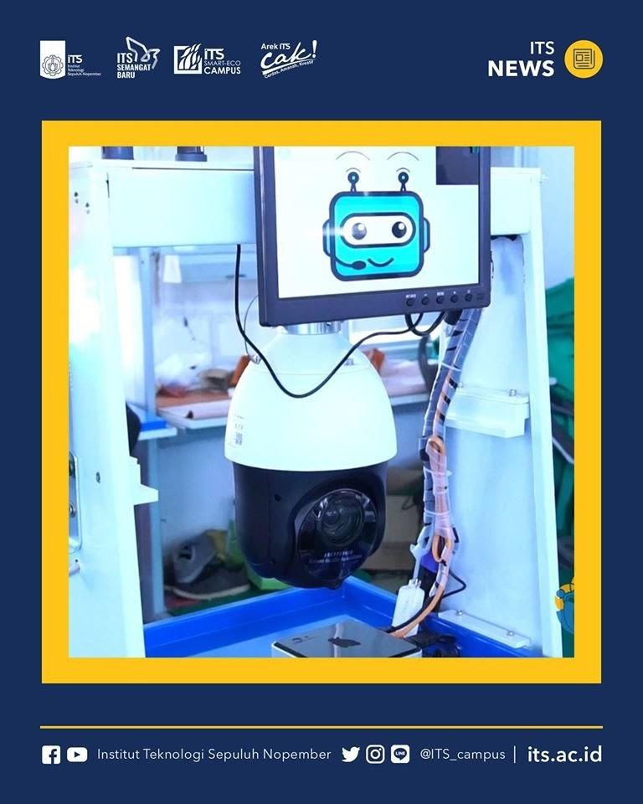
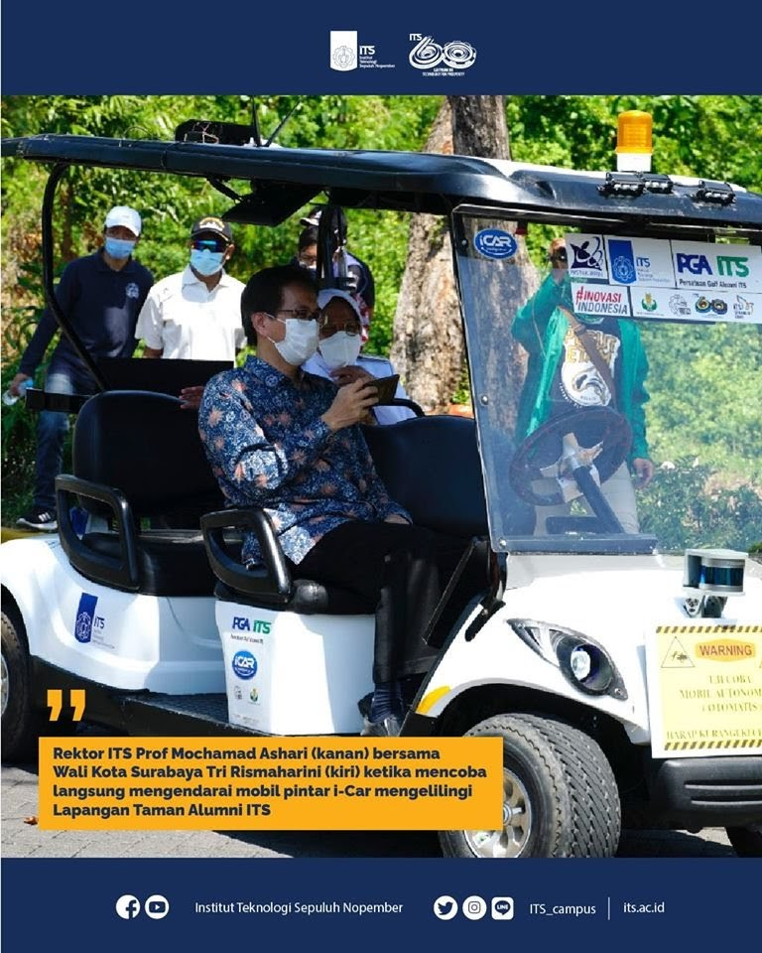
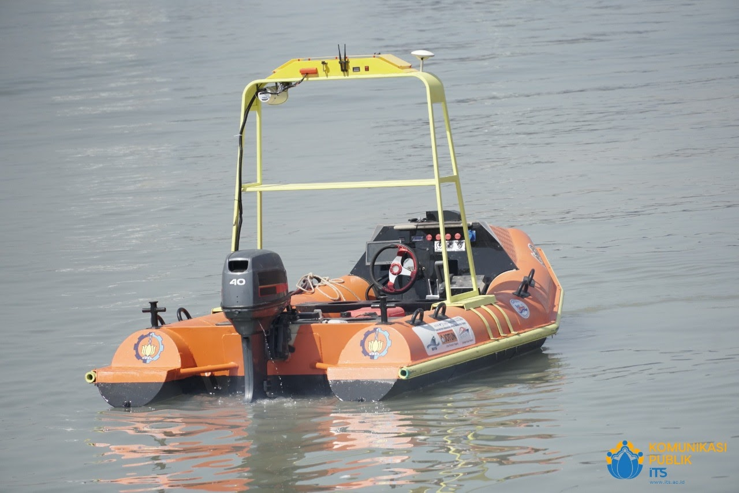
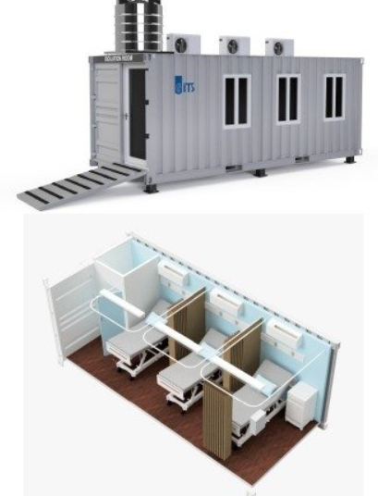
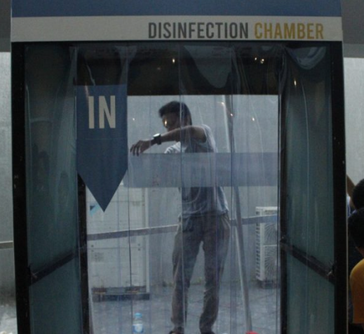
ITS INNOVATIONS DURING PANDEMICS
1
2
RAISA: Service Robot for COVID-19 Patients
I-Car: Intelligent Autonomous Car
I-Boat: Intelligent Autonomous Boat
PORTAHOS (Portable Hospital)
Disinfection Chamber
3
4
5

Slide 16
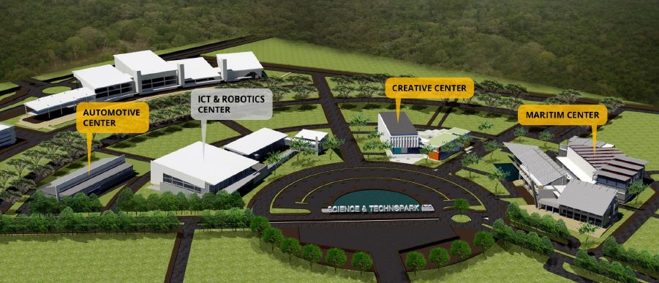
ITS TECHNOPARK

Slide 17
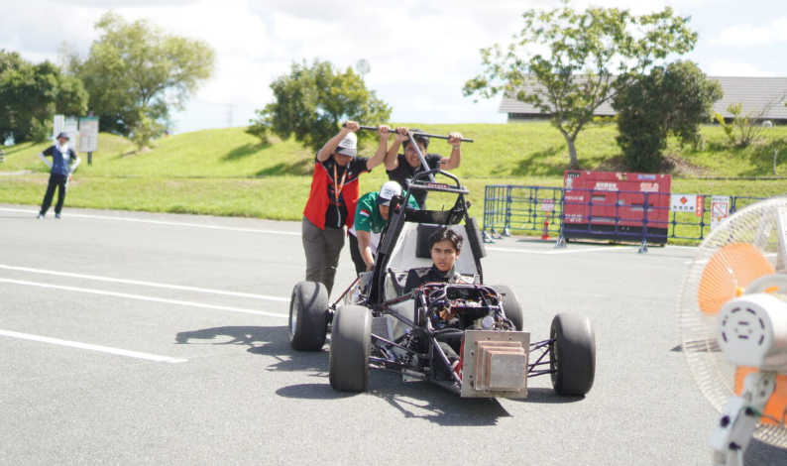
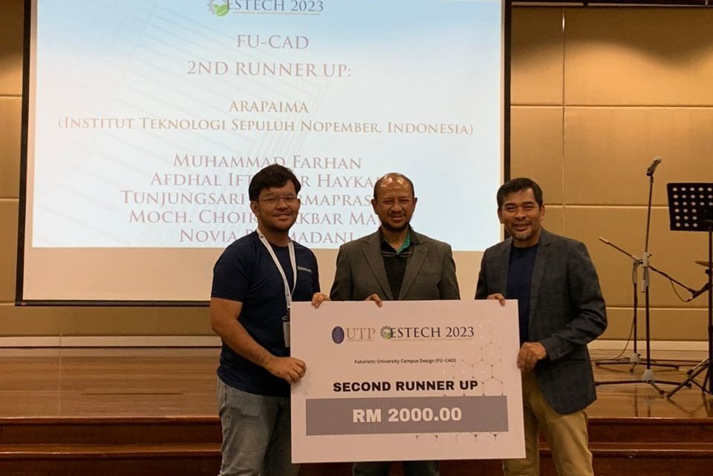
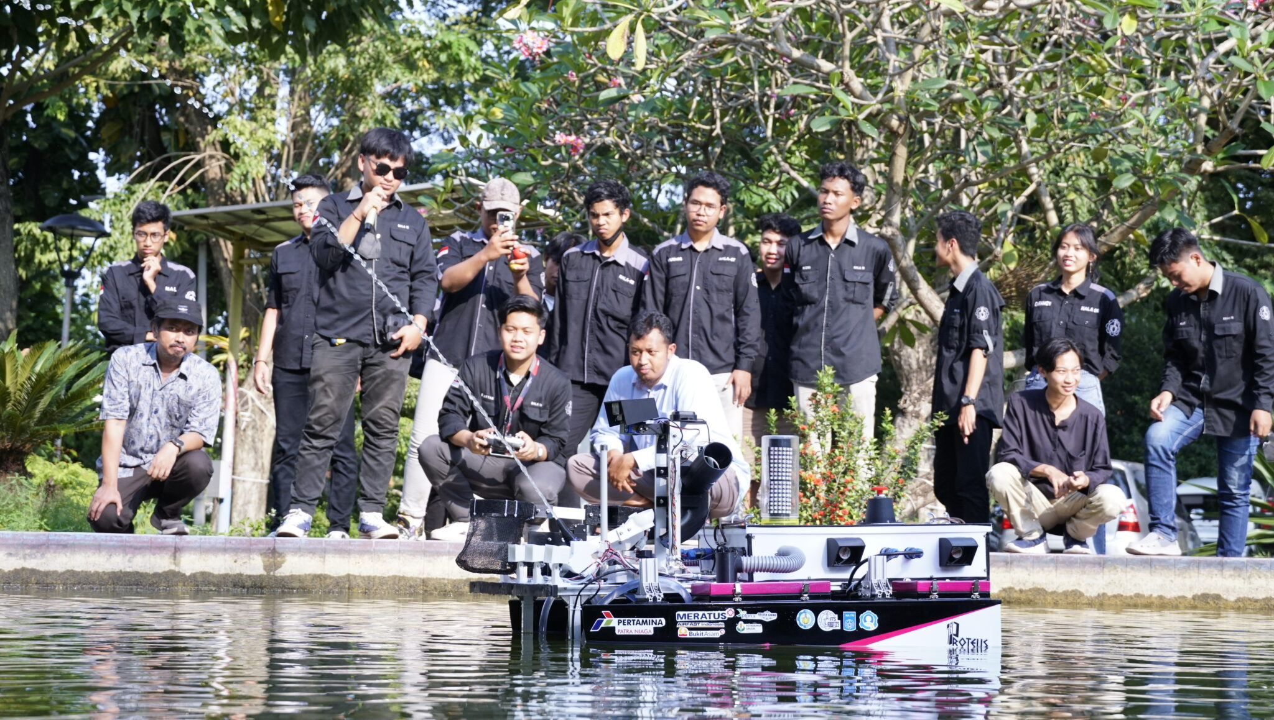
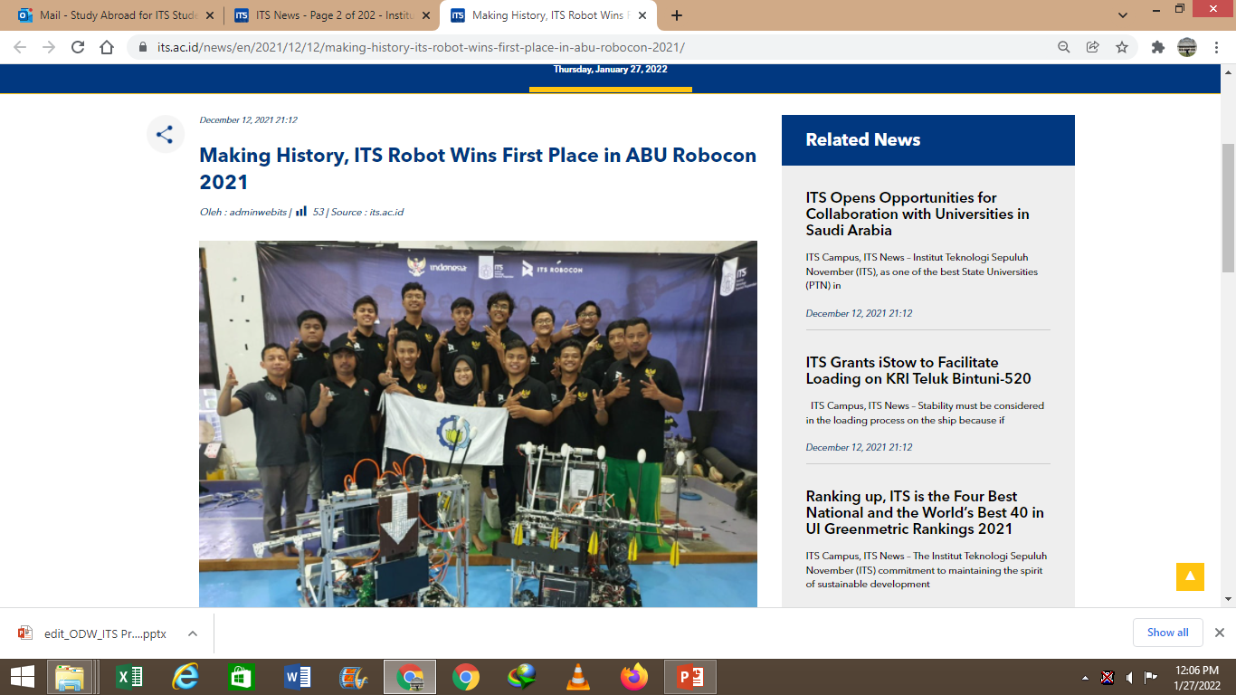
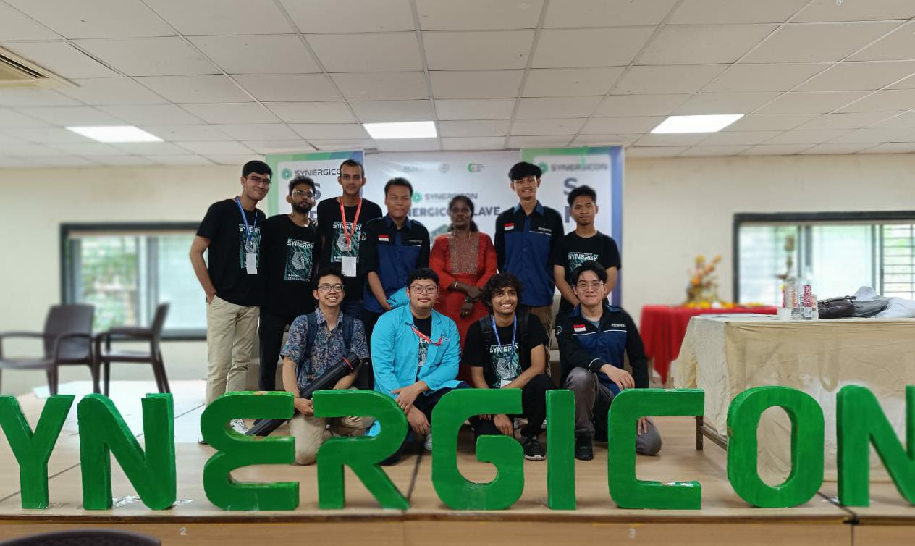
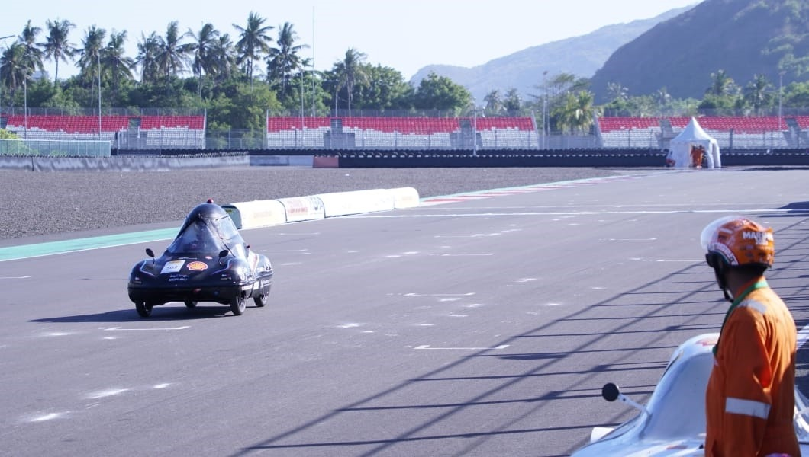
ITS STUDENTS’ INTERNATIONAL ACHIEVEMENTS
ITS Anargya team received 2 awards and the championship title at FSAE Japan 2023.
ITS Arapaima team clinched 3rd place in the Futuristic University Campus Design (FUCAD) competition held at Universiti Teknologi Petronas Malaysia.
ITS Spectronics team secured 1st place in the Race competition and 3rd place in the Poster Competition at the Synergicon Southern Asia Region Chem-E-Car Competition in India in 2023.
ITS Nawasena Team Won the Champion in the International Ferry Design Competition in the United States, 2023
ITS The Sapuangin team achieved first place on-track in the Urban Concept Internal Combustion Engine category at the Shell Eco-Marathon (SEM) Asia Pacific and Middle East event 2023.
ITS Barunastra Team Launches the Newest Roboboat to Conquer the United States, 2023

Slide 18
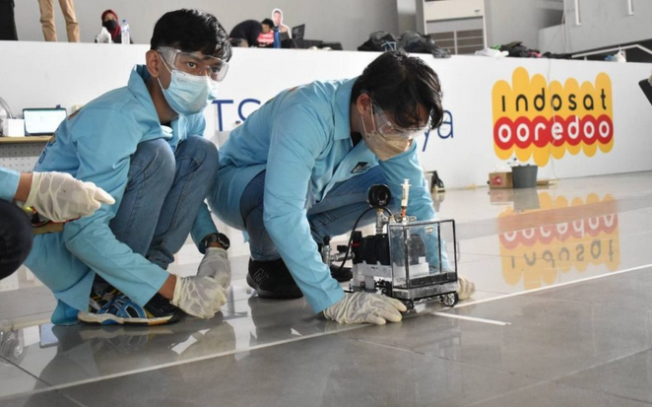
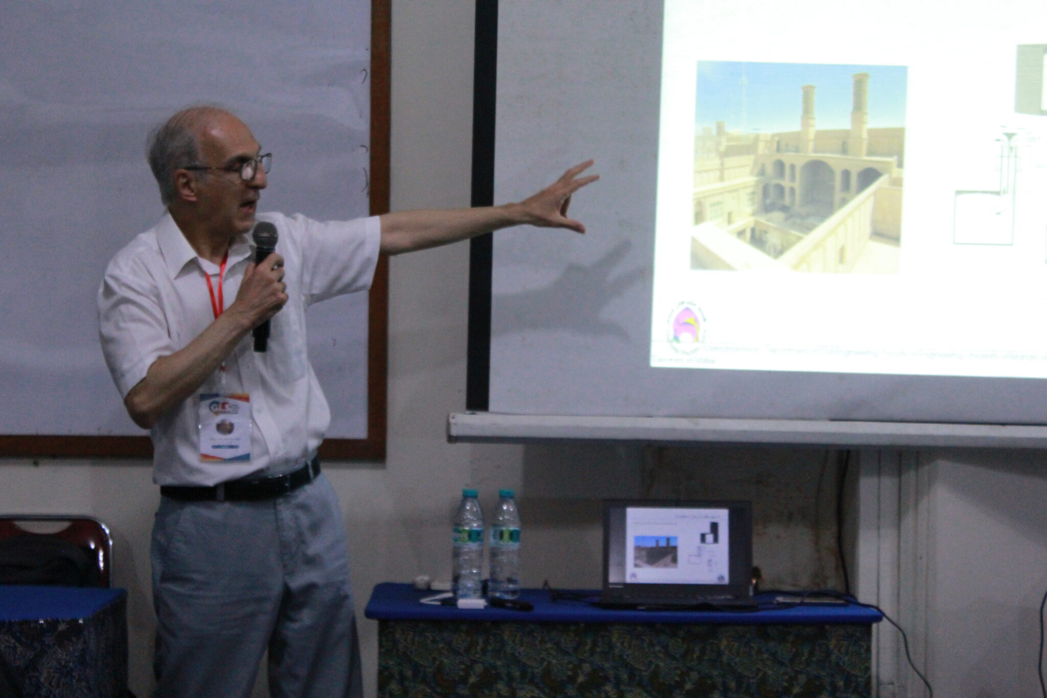
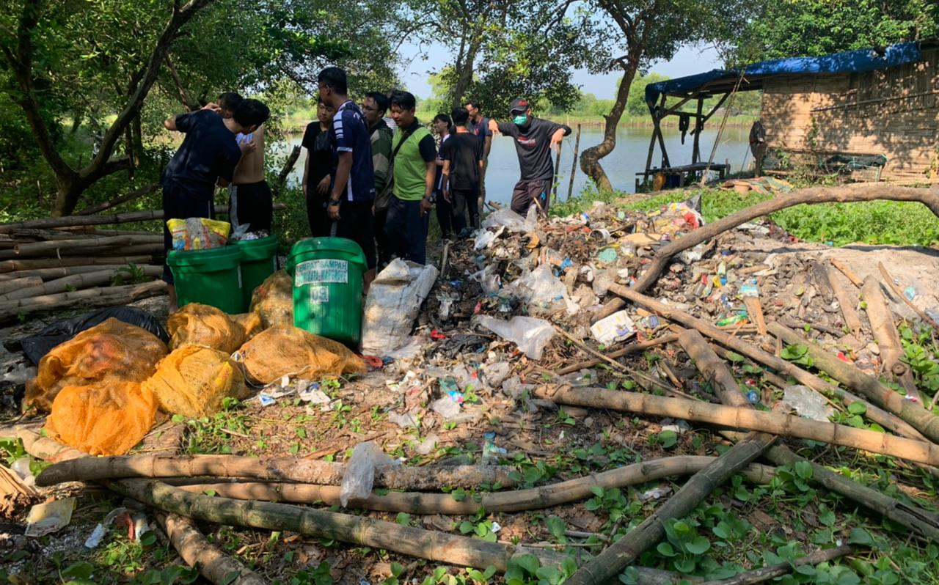
EXPERIENCING ITS!
A. International Students
B. International Lecturers
C. Non-Academic Staff
D. Global Citizens

Slide 19

International Students

Slide 20
KNB SCHOLARSHIP – MASTER & DOCTORAL DEGREE
Kemitraan Negara Berkembang Scholarship, widely known as KNB Scholarship, is a financial assistance offered by the Indonesian Government to prospective international students coming from developing countries to pursue their higher education degree in one of Indonesian universities. ITS offers Master’s and Doctoral degree under KNB Scholarships.
Scholarship Period
1 year of Indonesian language program (merger with 4 months of Preparatory program)
24 months (4 Semesters) of Master Program/36 months (6 semesters) of Doctoral Program
Application dates: February-April
Scholarship Coverage
  Living allowance
  Tuition Fee
  Immigration Fee
  Round trip ticket
  Health Insurance
  Research and book allowances
  1 year Bahasa Indonesia course
More Information:
https://knb.kemdikbud.go.id

Slide 21
THE INDONESIAN AID SCHOLARSHIP (TIAS) FOR BACHELOR’S AND MASTER’S DEGREE
The Indonesian Aid Scholarship (TIAS) is a financial assistance offered by the Indonesian Government to public servants coming from developing countries to pursue their higher education degree in one of Indonesian universities. ITS offers Bachelor’s and Master’s degree for Marine Engineering, Information System, Electrical Engineering, and Industrial and System Engineering under TIAS.
Scholarship Period
48 months (8 semester) of Bachelor program and 24 months (4 Semesters) of Master Program
Scholarship Coverage
  Living allowance
  Tuition Fee
  Immigration Fee
  Round trip ticket
  Health Insurance
  Research and book allowances
More Information:
https://tias.kemenkeu.go.id/

Slide 22
ITS POSTGRADUATE SCHOLARSHIP FOR MASTER’S AND DOCTORAL DEGREE
ITS Postgraduate Scholarship is a partial scholarship offered by ITS for prospective international students who would like to pursue their master’s and doctoral degree in ITS. The recipient of this scholarship must maintain GPA 3,0 in each semester.
Scholarship Period
24 months (4 Semesters) of Master Program/36 months (6 semesters) of Doctoral Program
Application dates: February-April
Scholarship Coverage
  Tuition Fee Waived
More Information:
https://www.its.ac.id/international/experiencing-its/prospective-student/scholarship/postgraduate-scholarship/

Slide 23
ENRICHMENT PROGRAM FOR GRADUATE STUDENTS
R2SEP (Researcher and Research Student Enrichment Program), https://www.its.ac.id/international/e-program/r2sep/
Academic Writing Center (AWC) and VELF from AWC

Slide 24
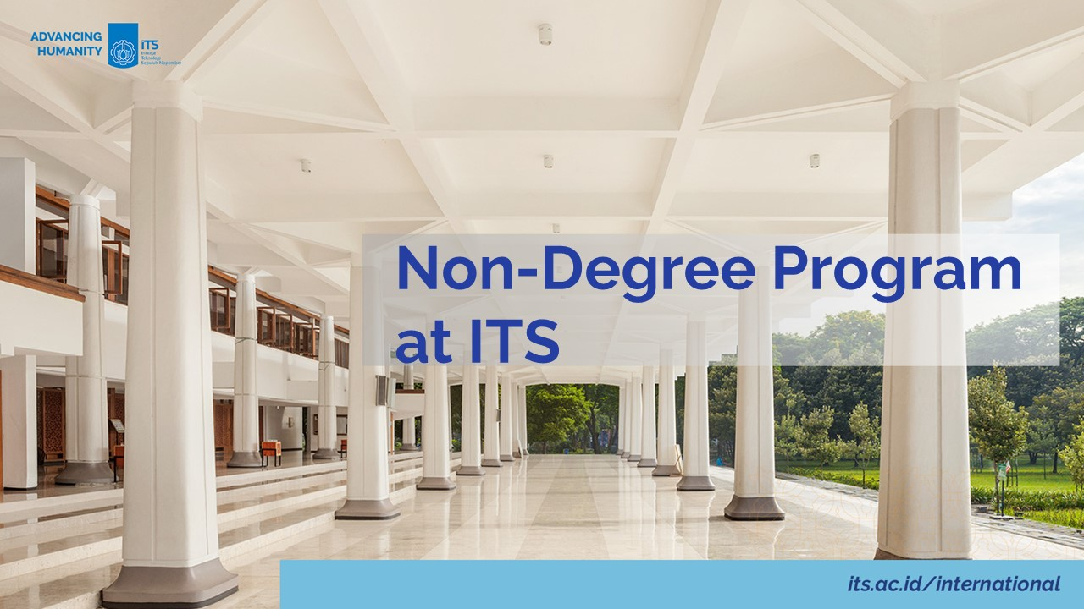

Slide 25
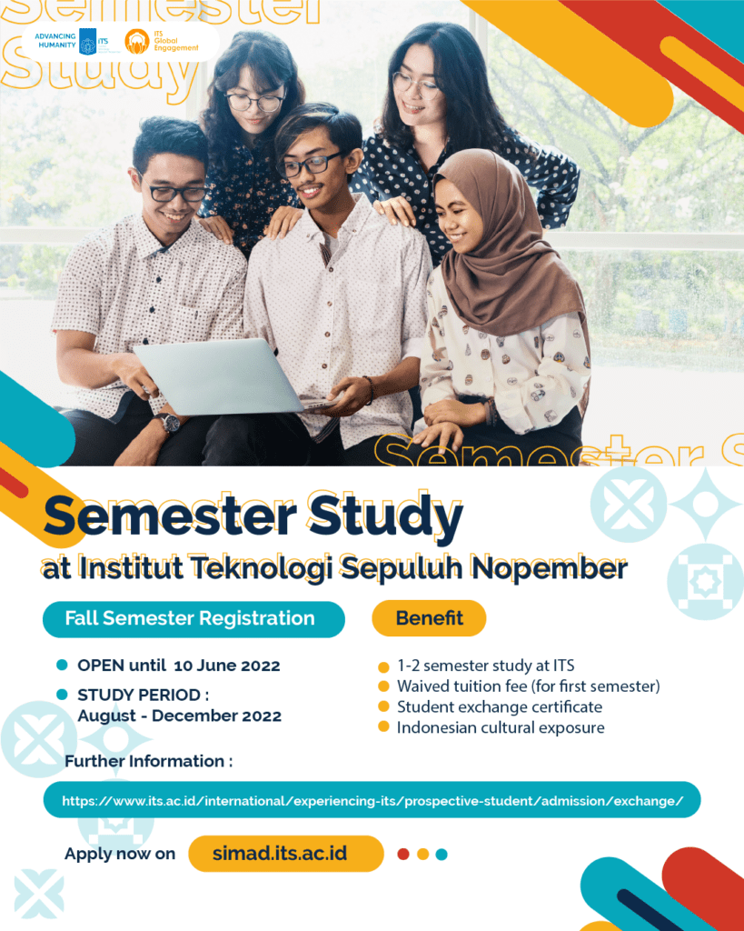
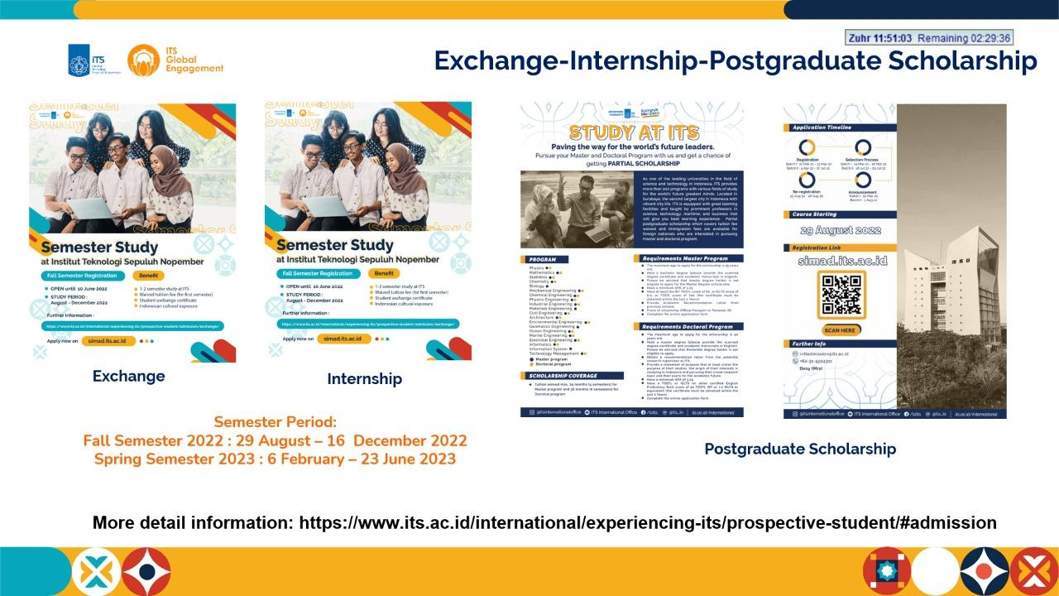
STUDENT EXCHANGE
Benefit:
Tuition Fee Waived
Credit Transfer
Indonesian Culture Exposure
Semester Period:
Fall Semester Nomination: April-June
Spring Semester Nomination: September-October
Max. Credit: 21 SKS
1 SKS = 36 study hours/semester
1 SKS = 1.6 ECTS

Slide 26
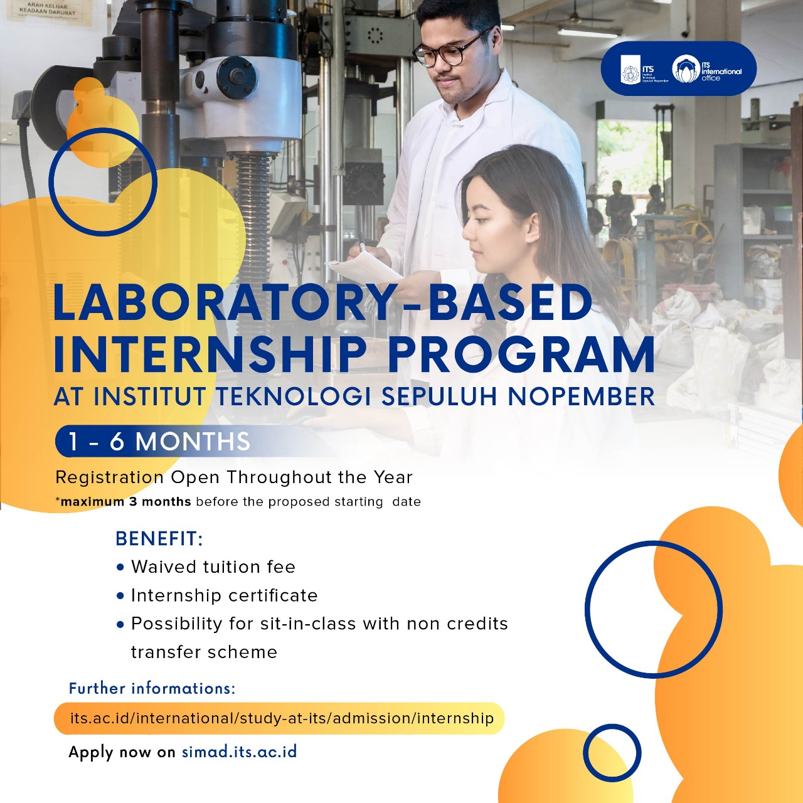

LAB INTERNSHIP PROGRAM
Benefit:
Tuition Fee Waived
Certificate of Completion
Indonesian Culture Exposure
Application Deadline :
3 months prior to the proposed starting date
More than
100
Interesting topics for Lab. Based
Internship Program
https://www.its.ac.id/international/experiencing-its/prospective-student/admission/internship/

Slide 27
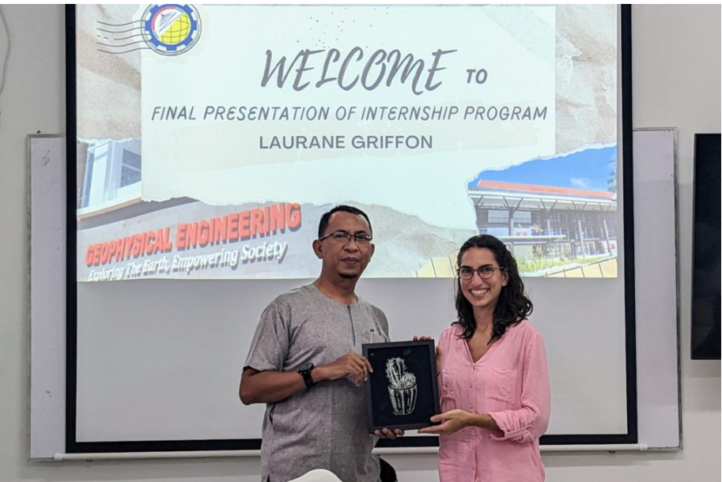
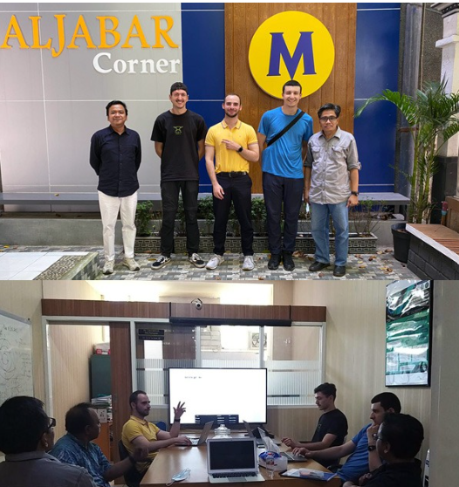
LAB INTERNSHIP PROGRAM
Ms. Laurane, Camille, Griffon,
CESI MONTPELLIER - France
International Internship Program – Data Science Math ITS – CY Tech University

Slide 28
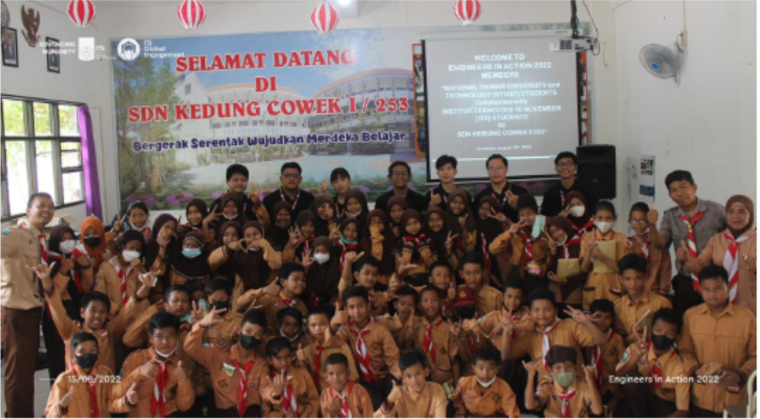
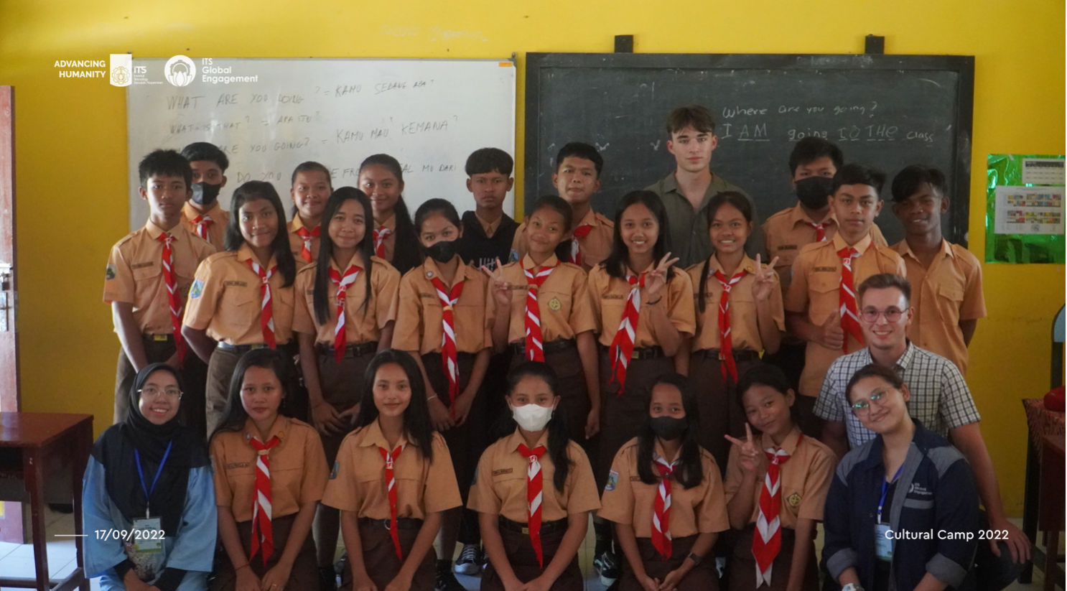
COMMUNITY-BASED INTERNSHIP
1 - 6 months
Institut Teknologi Sepuluh Nopember (ITS) collaborates with government institutions, Non-Governmental Organization (NGOs), and many communities in Indonesia to open opportunities for international students who are interested to engage with government institutions or councils, NGOs, and communities around Surabaya in particular topics or projects.
There are several topics you may choose for community-based internship program at ITS:
Development of Small and Medium Enterprises (SMEs) in Surabaya
Enhancing the utilization of BLC (Broadband Learning Center) - IT Centers for community at Surabaya
Technical, economic, and social study of aqua culture project at Indonesian coastal area
Development of seaweed plantation
Enhancing green life-style of Indonesian
Development of blue energy for blue economy
Teaching in elementary and secondary schools

Slide 29
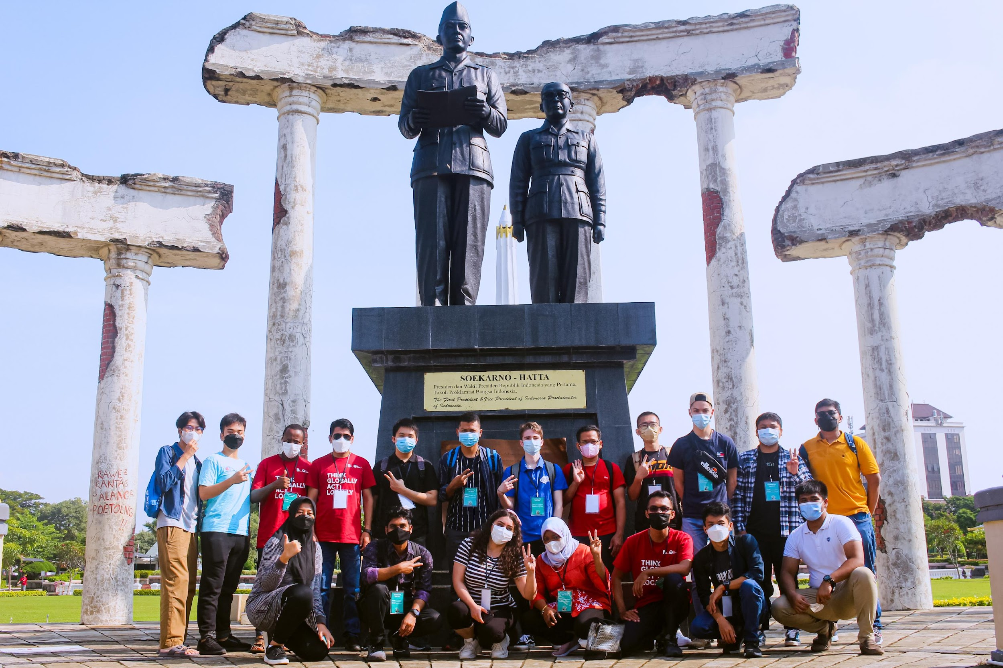
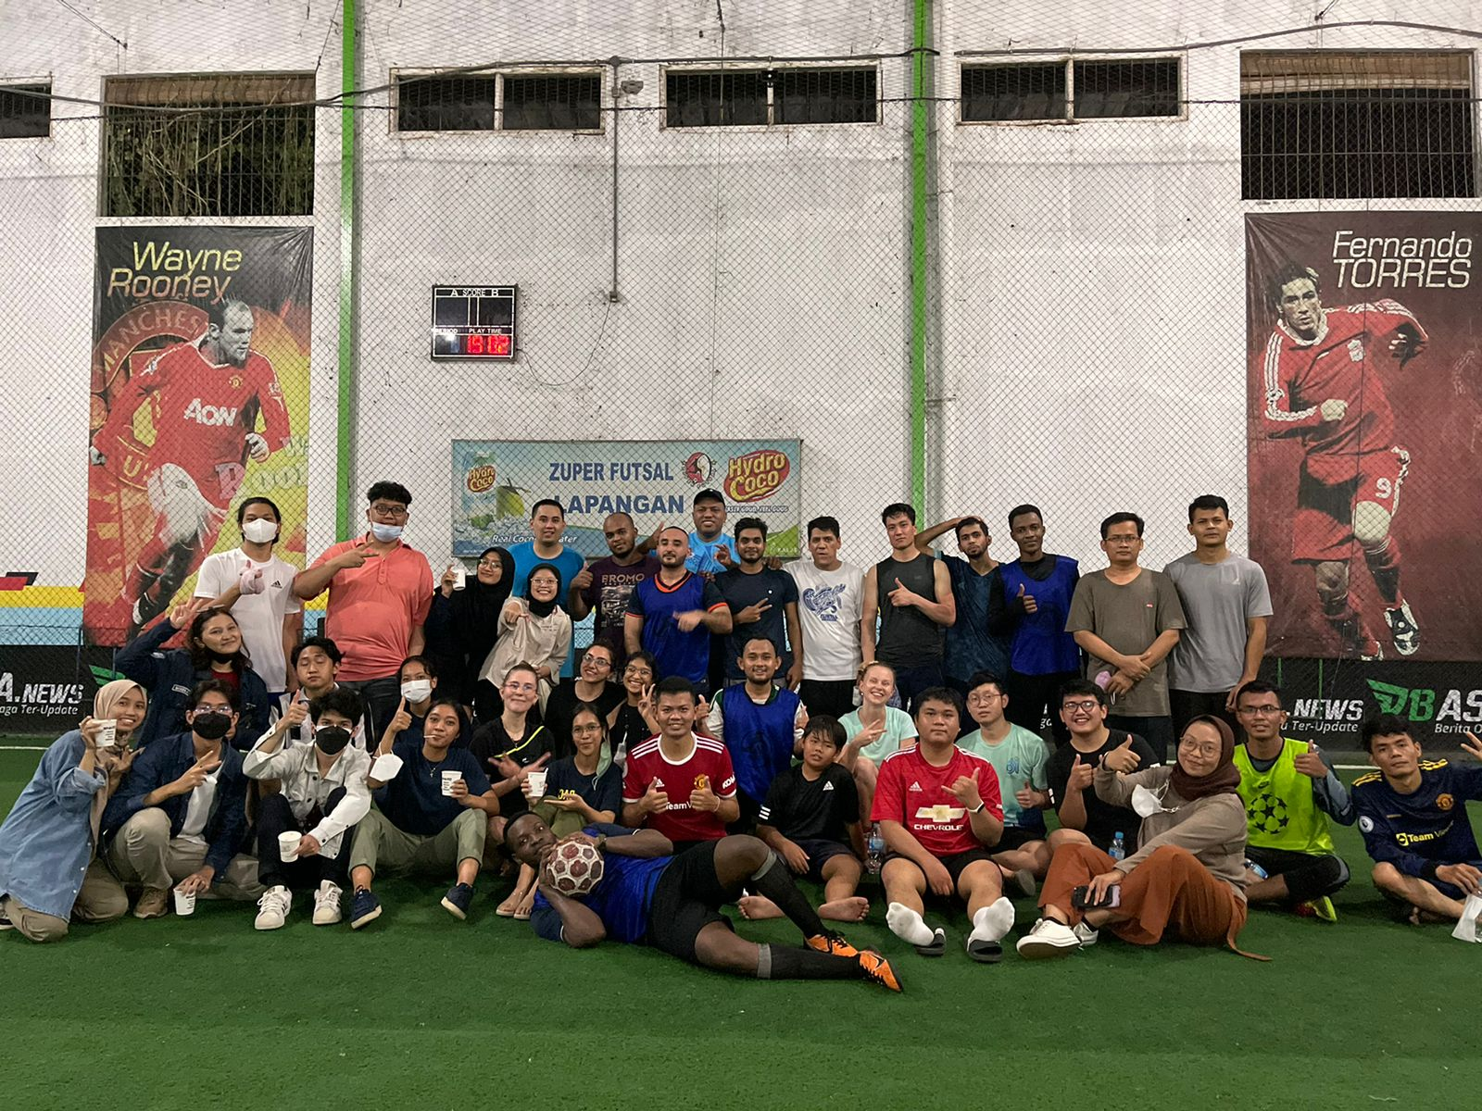
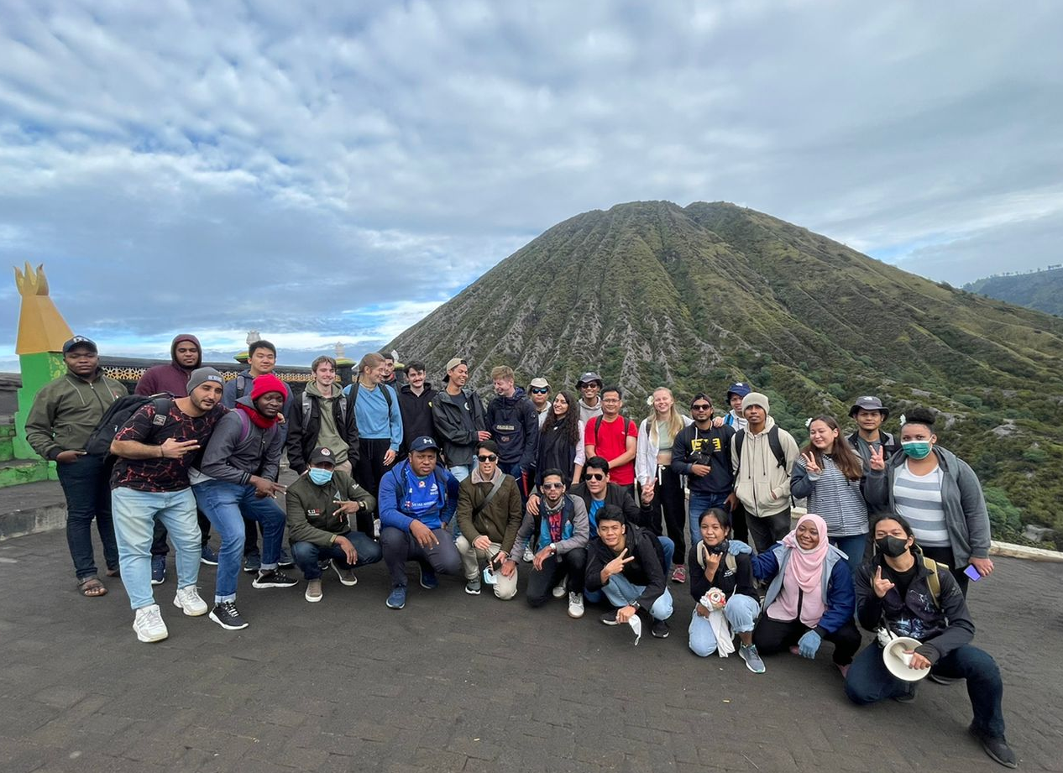
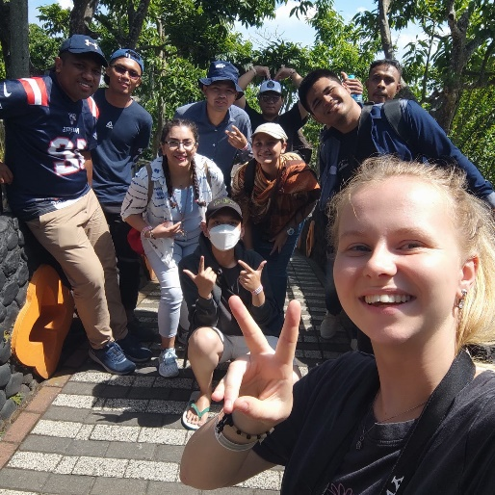
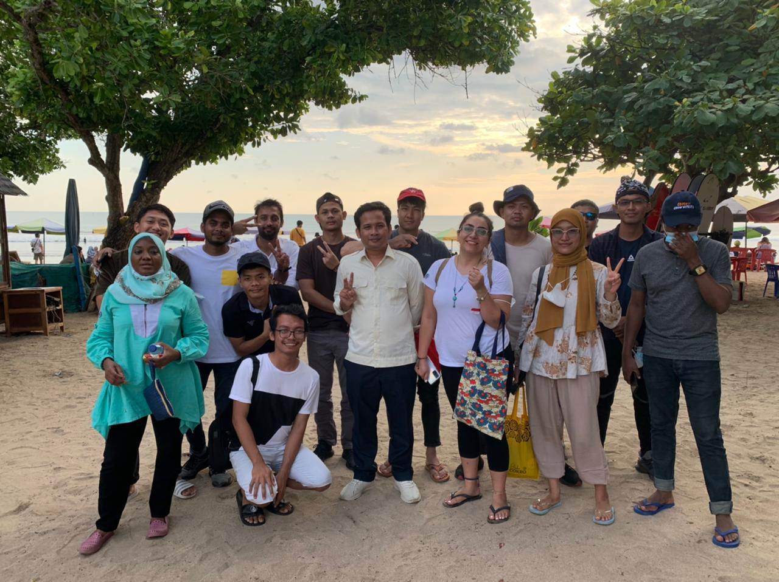
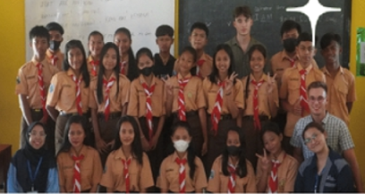
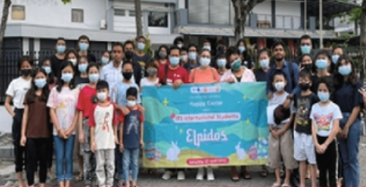

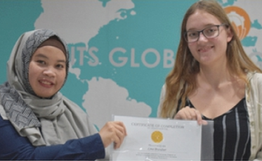
ACTIVITIES FOR INTERNATIONAL STUDENTS
Surabaya City Tour
Global Unity Fair
Orientation Week
Orphanage Visit
Cultural Camp
Sports Day
See You Soon
International Student Network
Campus Tour
Adventurous Trip : Bromo

Slide 30
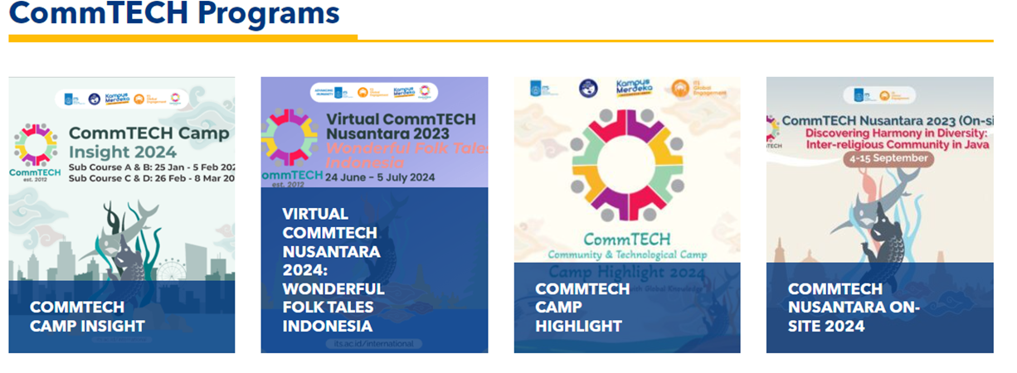
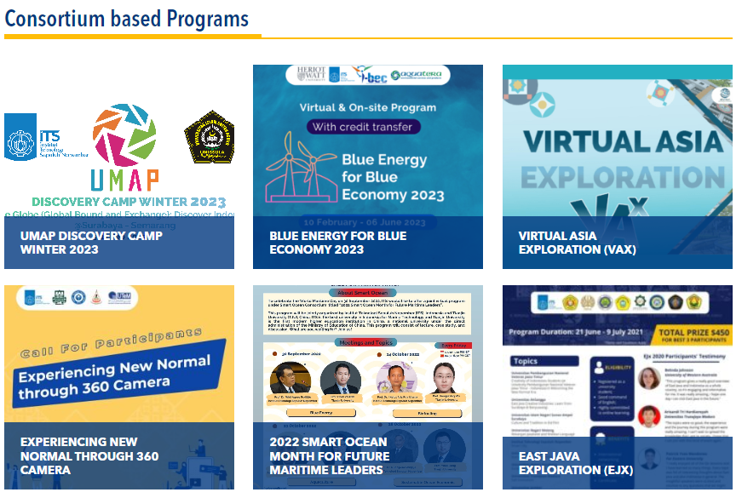
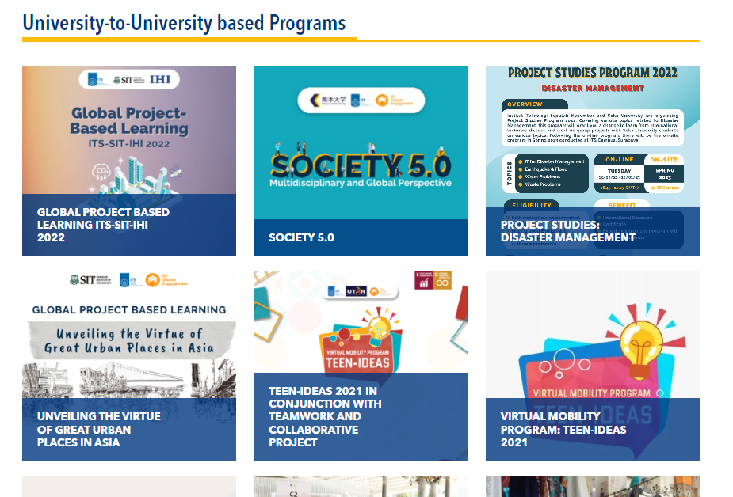
FLAGSHIP
SHORT PROGRAM
CUSTOMIZED SHORT PROGRAM

Slide 31
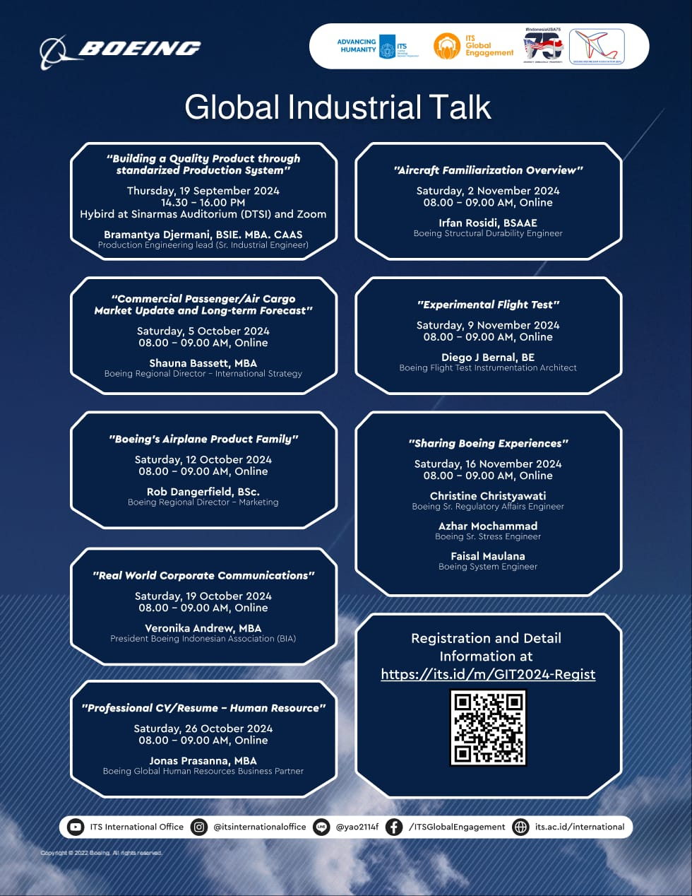





Global Industrial Talk
Global Industrial Talk is a credit earning short program with 8 meetings. This platform aims to expose the students to recent practice in the global industry with case studies of international companies such as Boeing, Rockwell, and IBM.
This initiatives also open opportunities for internships for students, as well as promoting research and innovations between university and industry.

Slide 32
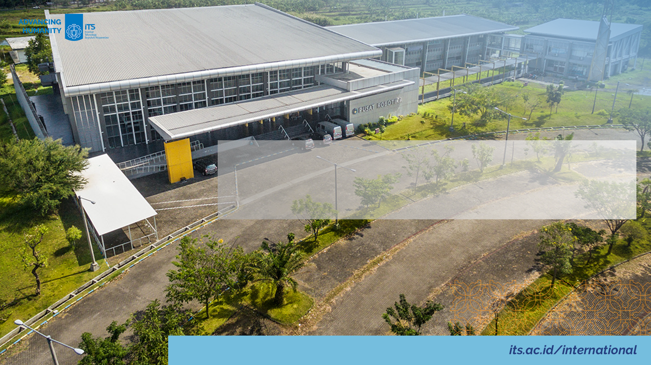
International Lecturers

Slide 33

GLOBAL LEARNING SERIES
Schedule :
Spring :
18-21 March 2024
26-31 May 2024
2-7 June 2024
Fall :
23-26 September 2024
21-25 October 2024
28 October-1 November 2024
Application
https://its.id/GLS-2024

Slide 34
International Lecturers Opportunities
Activities | Description | Benefit*
Visiting Professor | ITS welcomes senior academics, researchers and professors from overseas partners who wish to expand collaboration in exchanging expertise, teaching or carrying out research at ITS. | Access to teaching mobility funding offered by various resources
Adjunct Professor | Adjunct professors are defined as professors who are hired on a contractual basis. Adjunct professors at ITS Surabaya may choose one of two types: teaching-based or research/publication-based commitment. | Entitled to use ITS Adjunct Professor in business cards and during official correspondence Entitled to functional title at ITS, equivalent to the functional title at the home university, by adding “Adjunct” following to the title Easy and free access to ITS services such as library, working space, e-mail and research facility based on the need. Financial support for flight ticket, accommodation and per diem during your stay in Surabaya or honorarium for teaching.
*terms & conditions apply

Slide 35

INBOUND RESEARCHER MOBILITY for Top 200 & Non-Top 200* Universities
*based on QS WUR by Subject 2023

Slide 36
International Lecturers Opportunities
Activities | Description | Benefit*
Inbound Researcher Mobility (IRM) | Inbound Research Mobility (IRM) provides funding for overseas professors from Top 100 QS Rank by Subject to come to ITS Surabaya, Indonesia to conduct research and produce manuscript for international journal. The interested professor must contact an ITS faculty to apply for this funding. Outcomes of the program: Mandatory outcome: a manuscript of a joint publication to an international journal (Q1/Q2), Implementation of Arrangement (IA) document, official report. Non-mandatory outcomes: teaching activities, joint supervision, partnership agreement, etc. | ITS offers financial that may be used for return ticket, accommodation, health insurance, living expenses, or publication fee.
*terms & conditions apply

Slide 37
Staff Mobility

Slide 38


STAFF MOBILITY
INTERNATIONAL STAFF MOBILITY
Open for any non-academic staffs of ITS partners/prospective partners.
Session 1: 29 April-03 May 2024 | Registration deadline : 22 March 2024
Session 2: 7-11 October 2024 | Registration deadline : 30 August 2024
Application
Bit.ly/InternationalStaffMobilityITS

Slide 39
Global Citizens

Slide 40

VIRTUAL SHORT PROGRAM
Fun Bahasa Indonesia & Cultural Course
Open for Public who have interest to learn Bahasa Indonesia
Offer 4 themes
Free of charge
Application starts : 6 September 2024
Start on 1 November 2024
https://www.its.ac.id/international/experiencing-its/prospective-student/short-program/learning-bahasa-indonesia/fbicc/
40

Slide 41

DARMASISWA PROGRAM
Is a one-year non-degree scholarship program offered by the Indonesian government to all non-Indonesian for 10 months.
Coverage
Monthly living allowance
Accommodation and Transportation
Qualification
Foreign nationals
Completed secondary education or its equivalent
Minimum age 18 years old and not older than 27 years of age.
Able to communicate in English
https://darmasiswa.kemdikbud.go.id/

Slide 42






THANK YOU!
www.its.ac.id/international
@its_globalengagement
international@its.ac.id
intladmission@its.ac.id

